Slide 1
Crisis Informatics - an Excerpt
Part 1
Edward G. Happ
June 8, 2021

Slide 2
Four Lectures from SI-537+, Fall 2020
Part 1
3. History Of IT In Crisis Response And Major Cases (911, Indonesian Tsunami, Haiti, Tacloban, Syria)
4. A Framework For Understanding The Application Of Technology And Data To Crises
Part 2
16. Crisis And Cultural Context
19. COVID, Crisis Informatics and IT
Can we record this please?
Notes:
From SI-537, F2020, Lecture 3, 4, 12 (part 2); and ILO presentation of March 19, 2020.
From SI-537 Crisis Informatics - Lecture 3 FINALc.pptx, F2020
From SI-537 Crisis Informatics - Lecture 4 FINALb.pptx, F2020
From SI-537 Crisis informatics - Lecture 12 FINAL.pptx, part b, F2020
From my ILO presentation of March 19, 2020, “COVID, Crisis Informatics and IT FINALd.pptx”

Slide 3
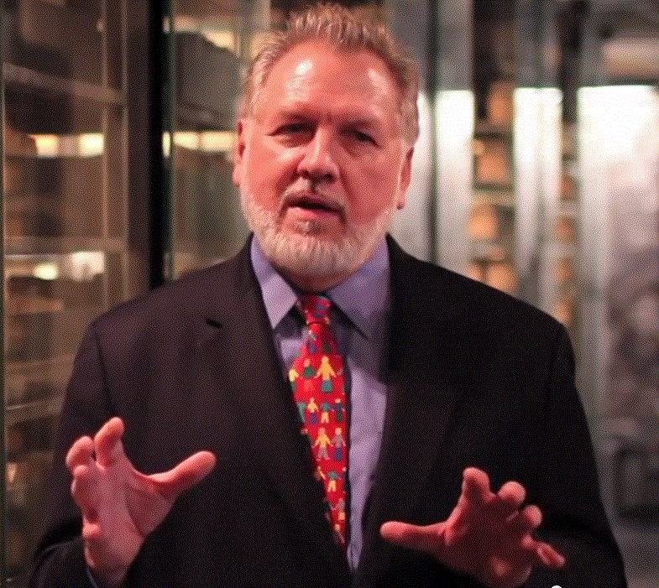
Who I Am…
4 years teaching Crisis Informatics and IT Mgmt
40 years in IT, 38 in IT mgmt
13 years on Wall Street
10 years in mgmt consulting
17 years in NGOs
Former Global CIO at IFRC
Former CIO at STC/US & UK
Co-founder and former Chairman of NetHope.org
More on LinkedIn, Google and www.eghapp.com
Making Connections for Good
– People, Comm’s, Ideas
Connect!
Notes:
When I was 38, I read a comment by Handy saying we could expect to have 5 careers;
For the millennials, US Dept. of Labor estimates you can expect to have 14 jobs…by the time they are 38! (see https://www.youtube.com/watch?v=XrJjfDUzD7M at 02:15)
http://www.amazon.com/The-Age-Unreason-Charles-Handy/dp/0875843018
Charles Handy, http://www.texasventures.us/india/images/leader2_1.jpg …five careers

Slide 4
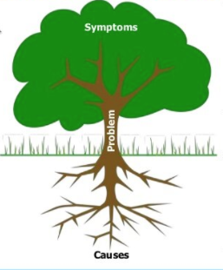
LTYM Story – Tell me three things
When I took over IT operations role for a Wall Street data provider, we knew pain that outages caused our customers. They often had millions of dollars on the line, and our data was a lifeline for their work.
When I first came on board, outages were too frequent. Operations and engineering teams felt that each crash was a disaster; assigning blame was first reaction once systems were back online. Fear ruled. If we were going to improve quality, that had to change.
I began asking 3 things whenever a problem occurred:
  Exactly what happened, what were root causes?
  What were we going to change to avoid it recurring?
  How were we going to be faster about recovery if it did happen again?
Situation Awareness: what happened
I made it clear: if we could answer these 3 questions, we didn't have a problem; we had a learning experience. People learned that this was expected result, and they worked hard to deliver. What happened is that teams shifted from blame to problem solving, quality went up
Notes:
LTYM #028 - http://www.hpmd.com/hpmd/personal/LTYMstories.nsf/links/028
Image credit: https://inspirecitizens.org/construct-a-root-cause-tree-or-fishbone-diagram-for-analyzing

Slide 5
3. Lecture - History of IT in Crisis Response
Notes:
From SI-537 Crisis Informatics - Lecture 3 FINALc.pptx, F2020

Slide 6
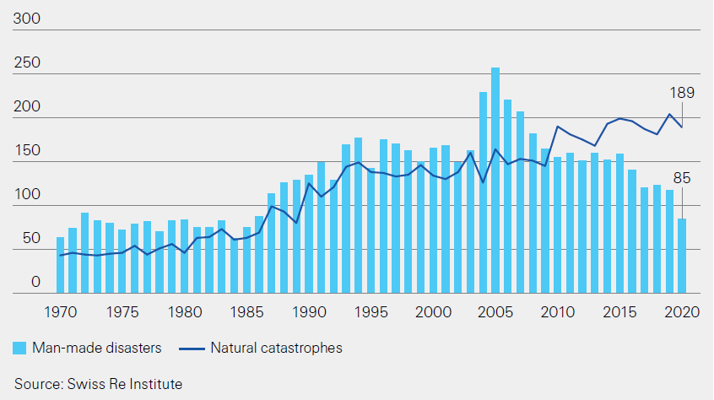
Number of Disasters* Continue to Rise
*Natural disaster trend is up, as “man-made” disasters decline (1970- 2020)
Notes:
Swiss Re, “Sigma” report, No. 1, Mar. 30, 2021, p. 23, https://www.swissre.com/institute/research/sigma-research/sigma-2021-01.html

Slide 7
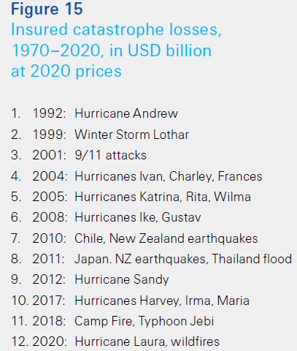
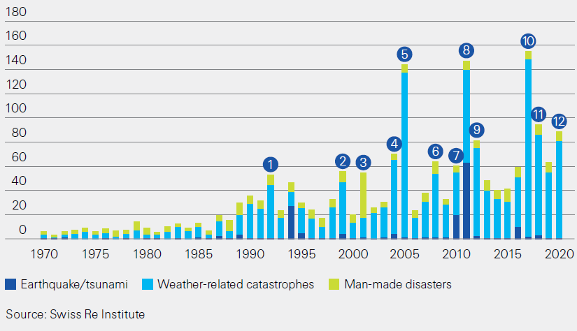
The Cost of Disasters is Rising ($B)
Notes:
Swiss Re, “Sigma” report, No. 1, Mar. 30, 2021, p. 24, https://www.swissre.com/institute/research/sigma-research/sigma-2021-01.html

Slide 8
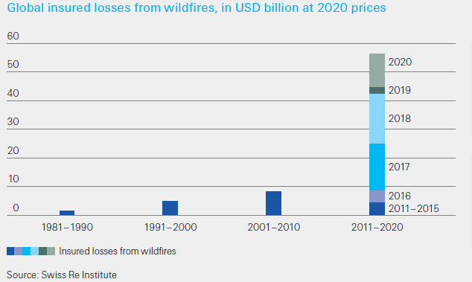
Current Decade of Wildfires ($B)
Insured losses from wildfires in 2017, 18, 20 highest ever
Notes:
Swiss Re, “Sigma” report, No. 1, Mar. 30, 2021, p. 8, https://www.swissre.com/institute/research/sigma-research/sigma-2021-01.html

Slide 9
Catastrophes

Slide 10
Factors of Crisis
Mild
Moderate
Severe
Catastrophic
Severity of Crisis
Personal
Commun-ity
Organiza-tion
Regional
Interna-tional
Scope of Crisis
LDC
Developing
Developed
Context of Crisis

Slide 11
Indonesia, Dec. 26, 2004
Indian Ocean Earthquake and Tsunami
280,000 deaths
Date | Time (UTC) | Place | Lat. | Long. | Fatalities | Magni-tude | Comments
Dec. 26, 2004 | 00:58 | Off the west coast of northern Sumatra, Indonesia see 2004 Indian Ocean earthquake and tsunami | 3.316 | 95.854 | 230,000~ 300,000 | 9.1 | M_{w} (USGS) Centred 250 km SSE of Banda Aceh, Sumatra, Indonesia, at a depth of 30 km. Most damage took place in Indonesia.
Notes:
https://en.wikipedia.org/wiki/List_of_21st-century_earthquakes

Slide 12
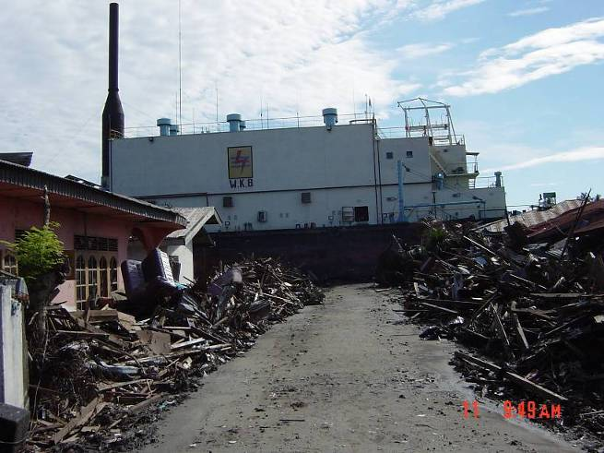
What is this large object?
a very large ship 5 miles inland in the middle of the road
Banda Aceh, Indonesia 2004
Notes:
Photo by Rui Lopes, Save the Children, 2004

Slide 13
Haiti, Jan. 12, 2010
Earthquake
160,000+ deaths
Date | Time (UTC) | Place | Lat. | Long. | Fatalities | Magnitude | Comments
Jan. 12, 2010 | 21:53 | Haiti region see 2010 Haiti earthquake | 18.443 | -72.571 | 160,000~ 316,000 | 7.0 | M_{w} (USGS) Centred 25 km WSW of PORT–AU–PRINCE, Haiti, at a depth of 13 km.
Notes:
https://en.wikipedia.org/wiki/List_of_21st-century_earthquakes

Slide 14
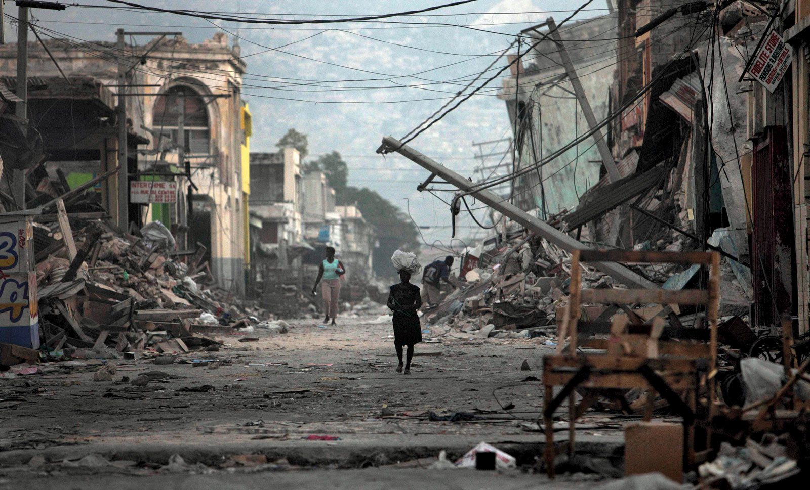
2010 Haiti Earthquake Damage
Notes:
Photo credit: https://www.britannica.com/event/2010-Haiti-earthquake

Slide 15
Philippines – Haiyan Cyclone, Nov. 2013
Cyclone
6,300 deaths
Rank^{[15]} | Storm | Dates of impact | Deaths
2 | Haiyan/Yolanda 2013 | 2013, November 7–8 | 6,300^{[16]}
*2nd deadliest cyclone in Philippines history
Notes:
https://en.wikipedia.org/wiki/Typhoons_in_the_Philippines

Slide 16
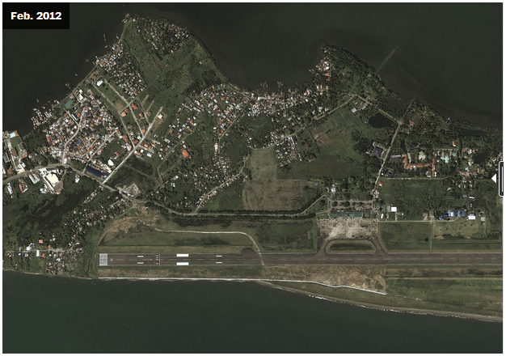
Tacloban Airport Before
16
Notes:
http://www.washingtonpost.com/blogs/worldviews/wp/2013/11/15/8-maps-that-explain-why-typhoon-haiyan-hit-the-philippines-so-hard/

Slide 17
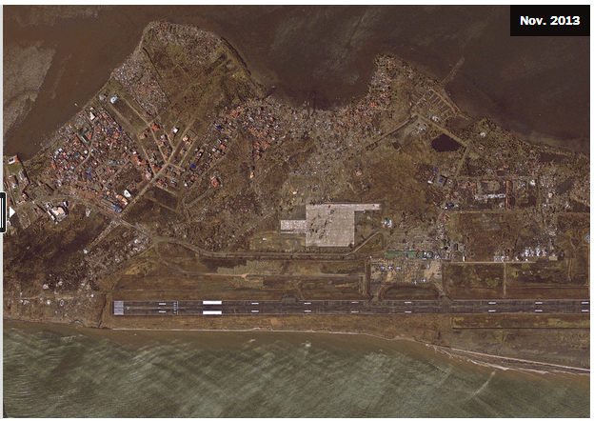
Tacloban Airport After
17
Notes:
http://www.washingtonpost.com/blogs/worldviews/wp/2013/11/15/8-maps-that-explain-why-typhoon-haiyan-hit-the-philippines-so-hard/

Slide 18
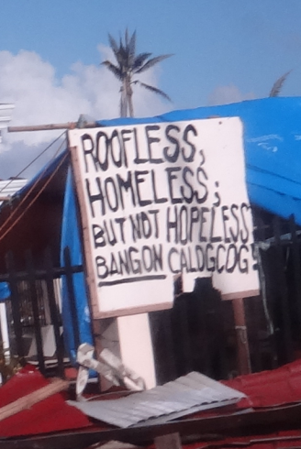
RC Philippines Response – Jan. 2014
By the Numbers:
16 million people affected
6,201 deaths reported
4 million people displaced
1.14 million houses damaged
Source: NDRRMC, 14 Jan. 2014
18
Notes:
IFRC: Philippines Typhoon Haiyan, FACT SitRep 20, 29 January 2014, pg. 1

Slide 19
Three ICT Things Different in Haiyan DR
Telco networks recovered before NGO VSATs were set up
BYOT extended to relief workers
ICT Collaboration worked
19

Slide 20
Japan – Tohuko Earthquake, Mar. 2011
Date | Magnitude | Name of quake | Japanese name | Rōmaji name | Epicenter | Death toll
March 11, 2011 05:46:23 UTC (14:46 JST) | 9.1 M_{w} | 2011 Tōhoku earthquake | 東北地方太平洋沖地震 (東日本大震災) | Tōhokuchihō Taiheiyō Oki Jishin (Higashi Nihon Dai-Shinsai) | 38.510°N 142.792°E , depth 29 km | 15,894 deaths,^{[73]} confirmed
Notes:
https://en.wikipedia.org/wiki/List_of_earthquakes_in_Japan

Slide 21
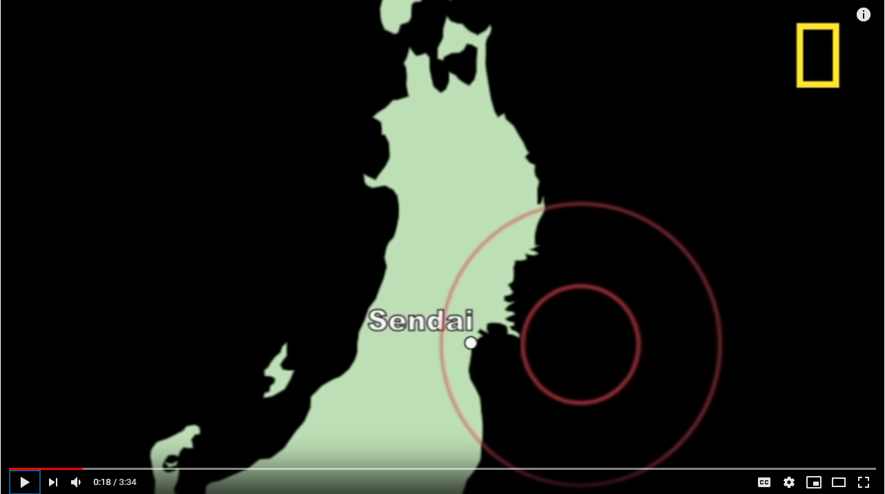
2011 Japanese Earthquake
https://www.youtube.com/watch?v=oWzdgBNfhQU [3:34]

Slide 22
Polling Time
For this week’s poll questions, please use your browsers to go to the link, below.
The link is also posted in Zoom chat and in the Slack #execises channel
Sli.do link:
https://app.sli.do/event/vtnle19n/live/polls

Slide 23
Syrian Civil War
This is the model for our SimEx lab
15 March 2011 – present
(9 years, 6 months)
More than 50% are refugees!
Total killed:
384,000-586,100 (Mar. 2020 SOHR estimate)
470,000 (Feb. 2016 SCPR estimate)
164,298 (Sep. 2018, VDC database estimate)
Over 7,600,000 internally displaced (2017 UNHCR estimate)
Over 6,253,784 refugees (Jul 2019 registered by UNHCR)
Population before the war: about 21 million
Notes:
https://en.wikipedia.org/wiki/Casualties_of_the_Syrian_Civil_War
https://en.wikipedia.org/wiki/Refugees_of_the_Syrian_Civil_War
https://data2.unhcr.org/en/situations/syria
Refugees of the Syrian Civil War - Total population:5,440,749 refugees (registered, December 2017)^{[1]}
6,130,000–6,320,000 refugees (based on UN estimate, March 2016)^{[2]}
“U.N.: Nearly half of Syria’s population uprooted by civil war,” Aug. 29, 2014
https://www.washingtonpost.com/news/morning-mix/wp/2014/08/29/
http://www.unhcr.org/53ff76c99.htmlu-n-nearly-half-of-syrias-population-uprooted-by-civil-war/?utm_term=.f52e19664feb

Slide 24
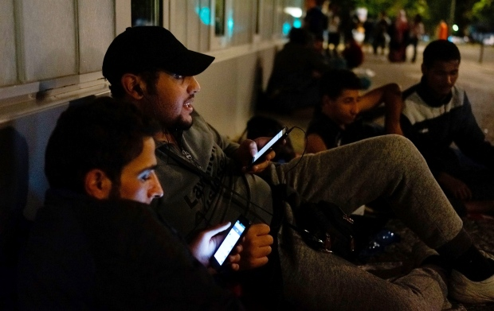
Syrian Refugees – Sep. 2015
Information to survive
“Refugees from Syria use smartphones to connect with relatives back home as they wait outside a government office in Berlin last month.” --Carsten Koall/Getty
Notes:
http://www.cbc.ca/news/world/for-syrian-refugees-smartphones-are-a-lifeline-not-a-toy-1.3221349

Slide 25
Three ICT Things Different in Syrian DR
Beneficiaries led in technology (73% of youth have smartphones)*
Top questions were about information (next slide)
Lack of coordination among receiving countries (getting better)
*Maitland and Xu study of Za’atari Refugee Camp, Jan., 2015
25
Notes:
https://www.researchgate.net/publication/315307842_A_Social_Informatics_Analysis_of_Refugee_Mobile_Phone_Use_A_Case_Study_of_Zaaatari_Syrian_Refugee_Camp
“a total of 151 out the 207 reporting at least one model, or 73% of reported phone are smartphones. “, p. 7

Slide 26
Top Questions of Refugees in Greece
Where am I?
Do you have WiFi?
Where can I buy food and water?
Where can I breastfeed my baby?
Where is the bus to Germany?
Can I take a taxi?
How do I register?
Why am I being fingerprinted?
How long must I stay here before I can leave?
Where can I change money?
--Tyler Jump (IRC), Huffington Post, 29-Oct-2015
26
Notes:
http://www.huffingtonpost.com/tyler-jump/common-questions-refugees-ask-when-arrive-europe_b_8400118.html

Slide 27
Why the facts and photos?
“Statistics don’t bleed; it is the detail which counts” --Koestler
Data alone does not bleed.
…With deference to Arthur Koestler
Notes:
“Arthur Koestler, in an oft-quoted comment of 1944, said that ‘a dog run over by a car upsets our emotional balance and digestion; 3,000,000 Jews killed in Poland cause but a moderate uneasiness. Statistcs don’t bleed; it is the detail which counts. We are unable to embrace the total process with our awareness, we can only focus on little lumps of reality.’”

Slide 28
"Developing countries suffer the greatest costs when a disaster hits – more than 95 percent of all deaths caused by disasters occur in developing countries, and losses due to natural disasters are 20 times greater (as a percentage of GDP) in developing countries than in industrialized countries.”
–Wikipedia, World Bank
Notes:
See http://en.wikipedia.org/wiki/Disaster
Also see http://www.worldbank.org/en/topic/disasterriskmanagement/overview

Slide 29
Disaster Risk vs. Vulnerability
Do more disasters hit more vulnerable countries?
Disaster Risk Score
Notes:
See Excel pivot table in: “Vulnerability versus Disaster Risk v3.xlsx” ; from the data in the previous slide sources

Slide 30
See the handout
?
Arrows indicate key shifts
Notes:
See “Disaster Response - ICT Factors v18.xlsx”

Slide 31
A Few Conclusions
Crisis Informatics is…
Information about crises (data, photos/videos, stories)
Information to be better prepared for crises (disaster preparedness and resiliency)
Information to make better decisions during crises (management)

Slide 32
4. Lecture - A Crisis IT Framework
Notes:
From SI-537 Crisis Informatics - Lecture 4 FINALb.pptx, F2020

Slide 33
A Personal Earthquake Story

Slide 34
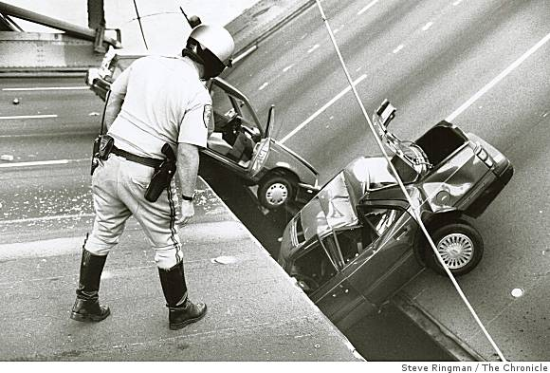
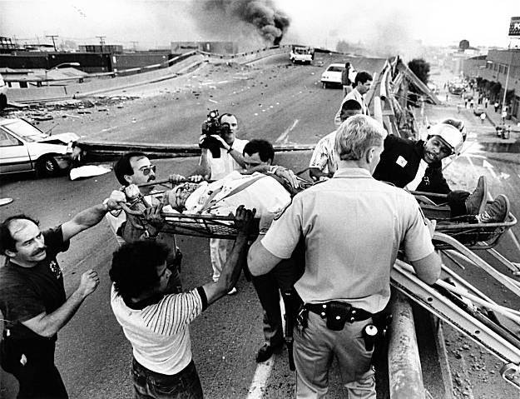
October 17, 1989
San Francisco, 5:04 pm
Loma Prieta 7.1
earthquake
34
Notes:
Photos: http://jellyjules.com/?p=2656
http://en.wikipedia.org/wiki/1989_Loma_Prieta_earthquake
LTYM #480, “Loma Prieta” http://www.hpmd.com/hpmd/personal/LTYMstories.nsf/links/480

Slide 35
Severity – levels of emergency

Slide 36
Complex Emergencies
“The designation of an L3 emergency, in consultation with the IASC* Principals, will be issued by the Emergency Relief Coordinator (ERC), on the basis of an analysis of 5 criteria: scale, complexity, urgency, capacity, and reputational risk.” --IASC System-Wide Emergency Activation, p.1
* IASC = Inter-Agency Standing Committee (UN operational agencies plus some large Int’l Org’s (IOs) like IFRC and ICRC)
Notes:
IASC = INTER-AGENCY STANDING COMMITTEE
Report is here: https://reliefweb.int/sites/reliefweb.int/files/resources/IASC%20System-Wide%20Activation.pdf p. 1

Slide 37
WFP Emergency Levels
World Food Programme (WFP) Emergency Response Classifications …according to a three-level scale:
Level 1 Response: Emergency operations within the response capabilities of the relevant WFP Country Office (CO), with routine support from Regional Bureau (RB).
Level 2 Response: Emergency Response operations requiring regional augmentation of country-level response capability.
Level 3 Response: Emergency Response operations requiring mobilization of WFP global response capabilities in support of the relevant CO(s) and/or RB, i.e. a Corporate Response.
--WFP Emergency Response Classifications, p.1
Notes:
WFP Emergency Response Classifications, p.1
http://documents.wfp.org/stellent/groups/public/documents/resources/wfp264770.pdf

Slide 38
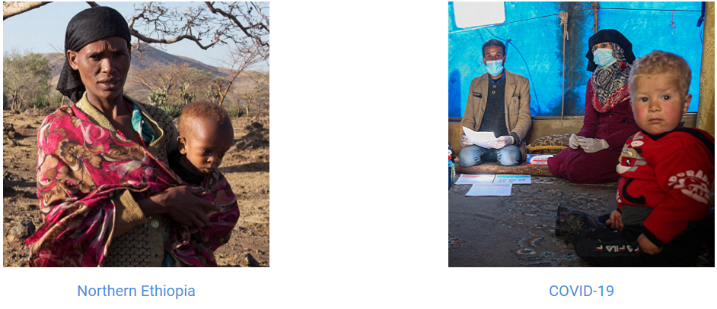
Current OCHA Level 3 Emergencies
https://www.unocha.org/where-we-work/current-emergencies
As of Jun. 2021
OCHA = UN Office for the Coordination of Humanitarian Affairs
Notes:
https://www.unocha.org/where-we-work/current-emergencies

Slide 39
Context – Where The Crisis Occurs

Slide 40
Crisis Context
It matters where you are in the world
1. LDC – 47 Least Developed Countries, like Haiti.
      Least Developed Countries (LDC) meet three criteria:
  Poverty – based on a three-year average estimate of GNI per capita for the period 2016-2018, based on the World Bank Atlas method (under $1,025 for inclusion, above $ 1,230 for graduation)
  Human resource weakness – Human Assets Index (HAI) based on indicators of: (a) nutrition: percentage of population undernourished; (b) health: mortality rate for children aged five years or under; (c) education: the gross secondary school enrolment ratio; and (d) adult literacy rate.
  Economic vulnerability – Economic Vulnerability Index (EVI) based on indicators of: (a) population size; (b) remoteness; (c) merchandise export concentration; (d) share of agriculture, forestry and fisheries; (e) share of population in low elevated coastal zones; (f) instability of exports of goods and services; (g) victims of natural disasters; and (h) instability of agricultural production. – UN Criteria
Notes:
http://unohrlls.org/about-ldcs/criteria-for-ldcs/
https://en.wikipedia.org/wiki/Least_Developed_Countries

Slide 41
Crisis Context (Con.t)
2. Developing Country, Like Barbuda & Antigua
Not much agreement on the definition here.
Was “defined … as low- and middle-income countries”, but dropped as a designation in 2015 –World Bank (based on global nature of the SDGs)
From an Crisis-IT perspective, it’s the middle third of the vulnerable countries index (see https://gain-new.crc.nd.edu/ranking/vulnerability)
SDGs= UN Sustainable Development Goals, which followed the MDGs=UN Millennium Development Goals
Notes:
http://blogs.worldbank.org/opendata/2016-edition-world-development-indicators-out-three-features-you-won-t-want-miss
http://blogs.worldbank.org/opendata/introducing-online-guide-world-development-indicators-new-way-discover-data-development
https://gain-new.crc.nd.edu/ranking/vulnerability

Slide 42
Crisis Context (Con.t)
3. Developed Country, like Switzerland
“one that allows all its citizens to enjoy a free and healthy life in a safe environment.” -- Kofi Annan, former Secretary General of the UN (2000)
For Crisis IT, it’s the top third of the vulnerable countries index (sorted low to high… next slide).
Notes:
http://unctad.org/en/Docs/ux_tdl365.en.pdf, p. 2

Slide 43
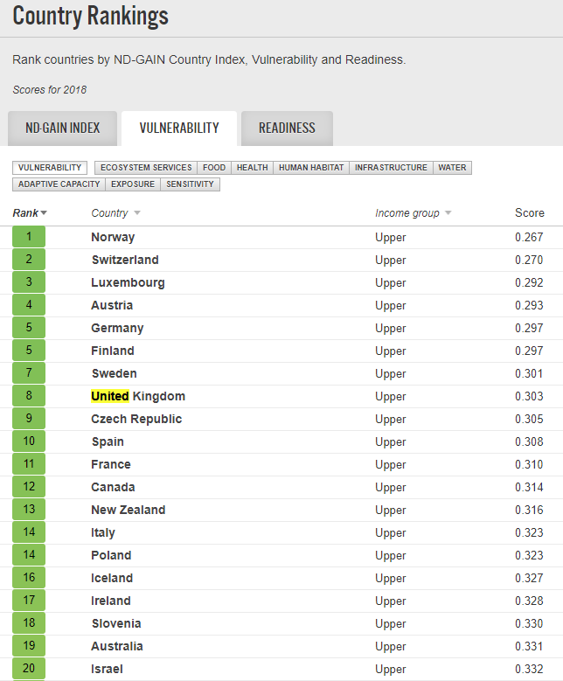
Least Vulnerable Countries
US is # 29
Notes:
https://gain-new.crc.nd.edu/ranking/vulnerability

Slide 44
Conclusions?
The most important take-away is that context matters.
    The scope, severity, location and timing determine which technology to apply.
Each audience has its own technology footprint
    Rule #1 is “know thy audience!”

Slide 45
Question & Answers

Slide 47
Pulling it all together
Technology is used to understand and communicate the historical trends, the pre-disaster, response, and post-disaster.
Can preserving data evolve with mining data? Is the “curatorial overload” a big data opportunity?
What can we learn from AI & data analysis (applied to the archives of digital narratives) that will impact disaster preparedness?
Over 1.3 billion Swiss francs were raised by the IFRC alone in 2010-2014, but was the vulnerability of the Haiti people improved?
Haiti’s vulnerability rank in 2018 was 167 of 181 countries (https://gain.nd.edu/our-work/country-index/rankings/ ). The big measures matter.
“The [911] attack knocked out 300,000 voice access lines and 4.5 million data circuits and left ten cellular towers inactive, depriving 14,000 businesses and 20,000 residential customers of service.”
--Paul Argenti, HBR, Dec. 2002. Communications matter.
Notes:
See the Haiti relief critique by Justin Elliott, ProPublica, and Laura Sullivan, NPR, “How the Red Cross Raised Half a Billion Dollars for Haiti ­and Built Six Homes,” June 3, 2015, https://www.propublica.org/article/how-the-red-cross-raised-half-a-billion-dollars-for-haiti-and-built-6-homes
Paul A. Argenti, [Tuck/Dartmouth] “Crisis Communication: Lessons from 9/11,” HBR, Dec. 2002 issue, https://hbr.org/2002/12/crisis-communication-lessons-from-911

