Slide 1
Two Kinds of Two Kinds of Social Media
Edward G. Happ
Global CIO, IFRC
Chairman, NetHope
March 2011

Slide 2
Three take-aways
Technology capacity building for the vulnerable needs to be clear about audience and intention (beware of unintended consequences)
The most important participants on the team are the beneficiaries; and the most relevant technologies are the ones that beneficiaries adopt
The prophets and the priests of technology can learn from each other

Slide 3
Two Kinds of Two Kinds of Social Media
Ushahidi,
Uncultured
RC Haiti
Student
Trashing
Policing by
Crowd-
sourcing
Good
Intentions
Bad
Intentions
Prophets,
Individuals
Priests,
Organizations

Slide 4
Two Kinds of Two Kinds of Social Media
Ushahidi,
Uncultured
RC Haiti
Student
Trashing
Policing by
Crowd-
sourcing
Good
Intentions
Bad
Intentions
Prophets,
Individuals
Priests,
Organizations

Slide 5
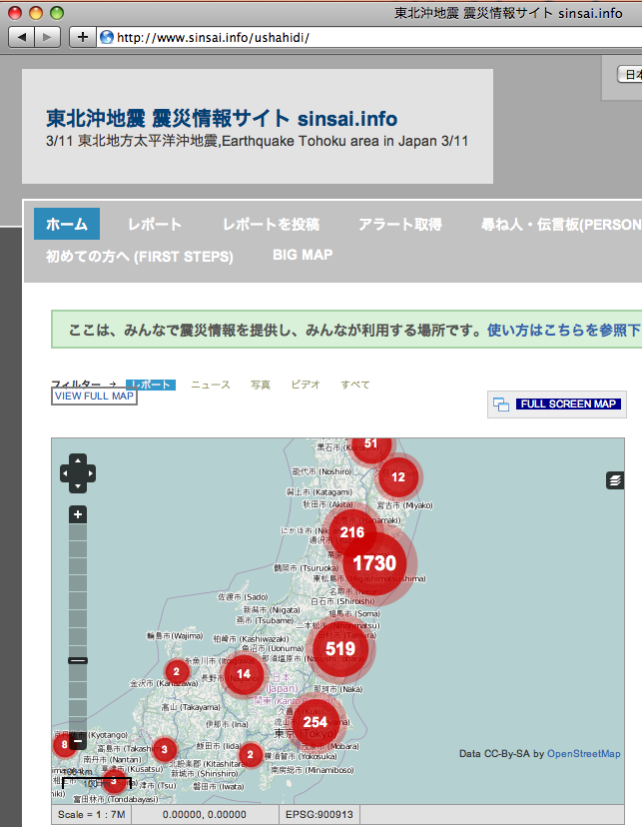
Crisis Mapping Japan’s Earthquake
almost 3,000 individual reports have been mapped
Notes:
http://blog.ushahidi.com/index.php/2011/03/16/crisis-mapping-japans-earthquake-and-how-you-can-help/
“Members of the Japanese OpenStreetMap community launched an Ushahidi platform for Japan just hours after the devastating earthquake struck the country. Less than 24 hours later, Japanese students at The Fletcher School in Boston (where the Ushahidi-Haiti project was run last year) mobilized to support the Tokyo-based crisis mapping project. Today, almost 3,000 individual reports have been mapped on the platform.” --Patrick Meier, 16 Mar 11
Also see: http://www.sinsai.info/ushahidi/

Slide 6
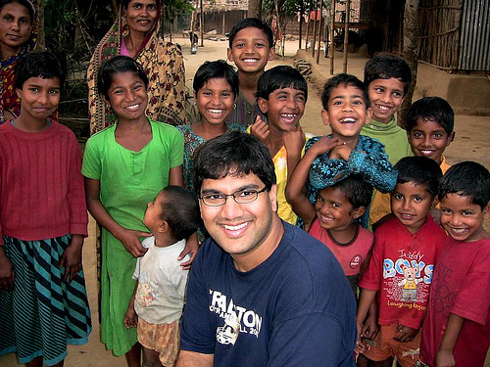
The Uncultured Project
2.2 M Views
6
Notes:
http://savetheworldblog.files.wordpress.com/2009/10/2606613587_44ea042f60.jpg
See Shawn Ahmed’s YouTube site, here: http://uncultured.com/

Slide 7
Two Kinds of Two Kinds of Social Media
Ushahidi,
Uncultured
RC Haiti
Student
Trashing
Policing by
Crowd-
sourcing
Good
Intentions
Bad
Intentions
Prophets,
Individuals
Priests,
Organizations

Slide 8
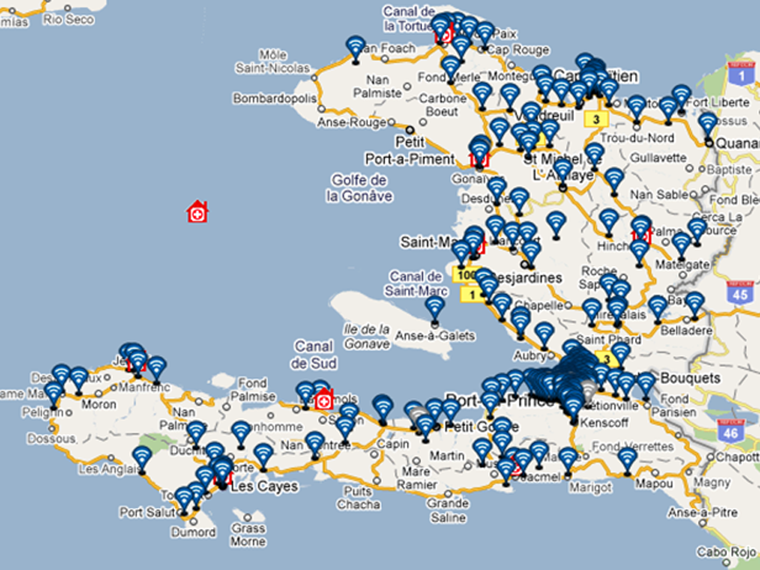
IFRC – Trilogy
TERA Application
Notes:
TERA = TRILOGY EMERGENCY RESPONSE APPLICATION
See http://www.ifrc.org/en/news-and-media/news-stories/americas/haiti/haiti-red-cross-takes-to-the-airwaves/

Slide 9
Texting Survivors in Haiti
6M SMS in 7 days
385K SMS/Day received
1.1M early warning SMS
1M Cholera health SMS
800K IVR calls in 1 month
Notes:
IFRC and Trilogy partnership: targeted SMS-based communications
6 million SMS sent during 7 days disaster preparedness campaign
385,000 messages received per day in PaP & Artibonite
1.1 million "early warning" SMS ahead of hurricane Tomas storm surges
Cholera: 2.1 million public health SMS sent:*733 IVR info-base; 800,000 calls to IVR in September
Survey potential
Beneficiary at the center of communications

Slide 10
Two Kinds of Two Kinds of Social Media
Ushahidi,
Uncultured
RC Haiti
Student
Trashing
Policing by
Crowd-
sourcing
Good
Intentions
Bad
Intentions
Prophets,
Individuals
Priests,
Organizations

Slide 11
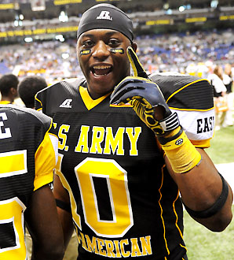
Top recruit quits Facebook following 'living nightmare'
Goodbye facebook.
"This is my last Facebook post and I'm gonna leave facebook with this. Linda Johnson [his mom] has never worked as a house worker making 100,000 dollars a year and I will not be a Mississippi state bulldog and I'm not considering Mississippi state anymore bc you have constantly comment on my page send me crazy inboxes and has made my recruiting experience a living nightmare. Goodbye facebook."
Notes:
Photo: http://sportsillustrated.cnn.com/2011/writers/andy_staples/01/26/facebook-recruiting-johnson/index.html
See article here: http://rivals.yahoo.com/highschool/blog/prep_rally/post/Top-recruit-quits-Facebook-following-living-nig?urn=highschool-313954

Slide 12
Two Kinds of Two Kinds of Social Media
Ushahidi,
Uncultured
RC Haiti
Student
Trashing
Policing by
Crowd-
sourcing
Good
Intentions
Bad
Intentions
Prophets,
Individuals
Priests,
Organizations

Slide 13
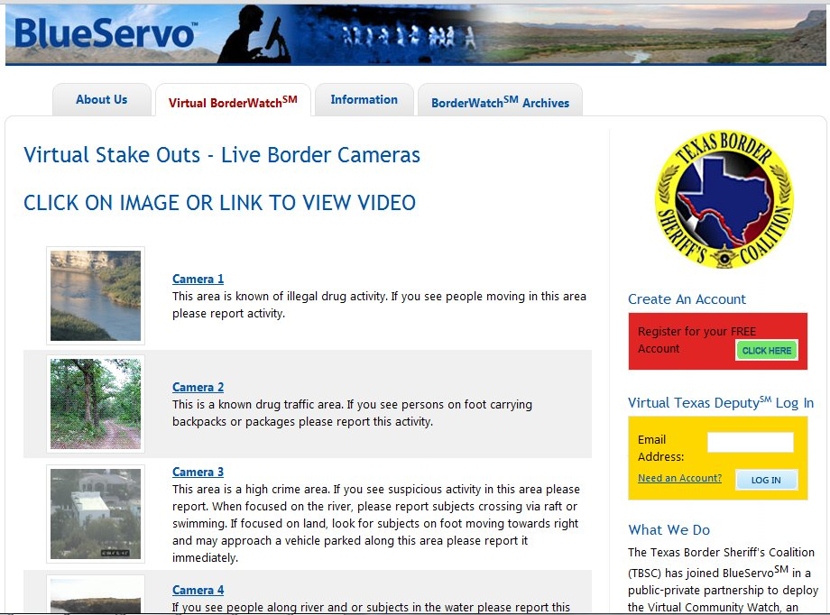
Crowd-sourcing the Border Patrol in Texas
Notes:
http://www.blueservo.net/vcw.php

Slide 14
Some things the Prophets don’t want to hear
?
“James Gleick is asking whether information has become the new crack. Evgeny Morozov and Malcolm Gladwell are asking whether it really is the case… that more Internet always means more freedom and openness. Nicholas Carr is asking whether we are losing our powers of reading and writing. Scientists around the world are asking what this new oxygen of constant connectedness does to our brains.” –International Herald Tribune
Notes:
“Reality Crashes the Technocrats' Party,” By ANAND GIRIDHARADAS, March 26, 2011, http://mobile.nytimes.com/article?a=765939

Slide 15
Some things the Priests don’t want to hear
“Cloud computing - any computing over the Internet- just isn't as good as enterprise computing. It's not as secure, not as fast, not as reliable as your internal network. But like all disruptions, it's getting bigger and better. As it does, it pulls applications, one by one, out of the corporate network into its world. ”
--Clay Christensen,
Notes:
“What CIOs Get Wrong About Emerging Technology”, interview with Clay Christensen, By Kim S. Nash, CIO magazine, December 15, 2009, http://www.cio.com/article/print/510968

Slide 16
The Problem of Unintended Consequences
Higher participation
Untimely decision-making
Increased demand for fast data
More work responding to HQ than for Field
Faster communication with email
Cannot read all the daily email

Slide 17
Flows of Data to Crises Response
UN NGOs
1.0 Data volume
Flows of Data to Crises Response
“Disaster Relief 2.0”,
UN Foundation report, March 2011

Slide 18
Data Overload
Volunteers
Techs
UN NGOs
Beneficiaries
1.0 Data volume
2.0 Data volume
Flows of Data to Crises Response
“Disaster Relief 2.0”,
UN Foundation report, March 2011

Slide 19
Two Kinds of Two Kinds of Social Media
Ushahidi,
Uncultured
RC Haiti
Student
Trashing
Policing by
Crowd-
sourcing
Good
Intentions
Bad
Intentions
Individuals
Organizations

Slide 20
Challenges in need of Solutions
Relevance
Is it actionable?
Verification and authentication
Is it true? Is it a hoax?
Duplication
Has this already been dealt with?
Access
Do the most vulnerable have the tools?
Notes:
Relevance: Fast information is not the same as actionable information. Hearing about an earthquake on Twitter before it shows up on the website of the US Geological service is interesting, but does not help to prepare the response.
Access: In a first aid course you learn that the person who shouts the loudest is not the one you should necessarily focus on first. The priority is the unconscious person lying next to him. In a similar way we have to ask us whether the people tweeting after a disaster are always the ones who need help most urgently, particularly in a large scale disaster that requires response in a systematic, large scale way and cannot always respond to individual cries for for example shelter or water. People buried under rubble are obviously a different matter.

Slide 21
Challenges in need of Solutions (cont.)
Privacy
Is confidentiality respected? Security risks?
Expectations
Are we creating unrealistic expectations?
Impact
Converting Data into Aid delivery?
Proximity
Understanding new proximity dynamics
Notes:
Relevance: Fast information is not the same as actionable information. Hearing about an earthquake on Twitter before it shows up on the website of the US Geological service is interesting, but does not help to prepare the response.
Access: In a first aid course you learn that the person who shouts the loudest is not the one you should necessarily focus on first. The priority is the unconscious person lying next to him. In a similar way we have to ask us whether the people tweeting after a disaster are always the ones who need help most urgently, particularly in a large scale disaster that requires response in a systematic, large scale way and cannot always respond to individual cries for for example shelter or water. People buried under rubble are obviously a different matter.

Slide 22
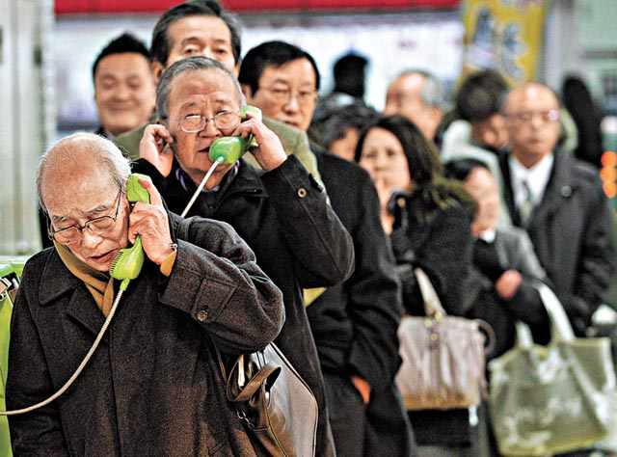
People need to know their loved ones are safe
Notes:
http://voices.washingtonpost.com/blog-post/tsuna.JPG

Slide 23
Wisdom from Japan
A barber in north Japan “was giving free haircuts on Thursday with scissors and a razor borrowed from a friend in a nearby town.
‘We have to support each other,’ he said, ‘and this is what I know how to do.”
–International Herald Tribune, 27 March

Slide 24
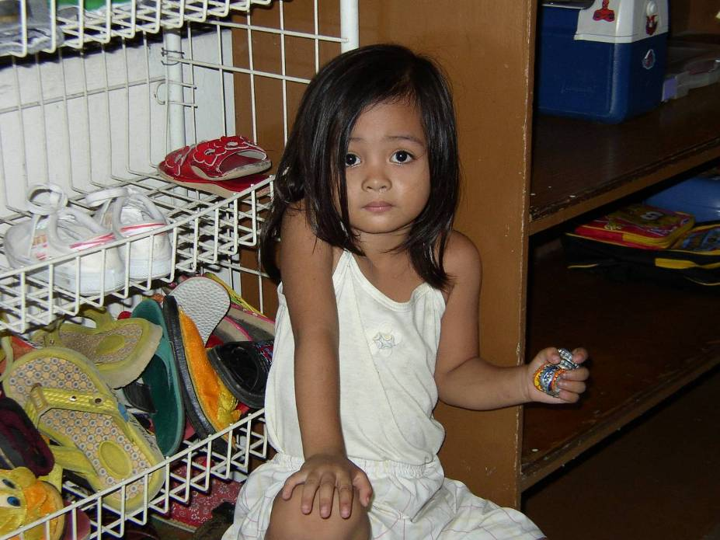

Slide 25
Bottle-caps
Simple, basic toys are good enough
She brought her toys with her to the center
She had already adopted these toys as hers
Now change the word
“toys” → “technologies”

Slide 26
Three take-aways
Technology capacity building for the vulnerable needs to be clear about audience and intention (beware of unintended consequences)
The most important participants on the team are the beneficiaries; and the most relevant technologies are the ones that beneficiaries adopt
The prophets and the priests of technology can learn from each other

Slide 28
Appendix

Slide 29
Two Kinds of Two Kinds of Civil Religion – Martin Marty, 1974
Robert
Bellah
National/Self-
Transcendence
Transcendent
Deity
Prophetic
Priestly

Slide 30

Spreading the word on Twitter
Tue
12
Jan 2010
Thu
14
Jan 2010
2.3M tweets
#Haiti
#Red Cross
7.0 Mw earthquake
hit Haiti

Slide 31
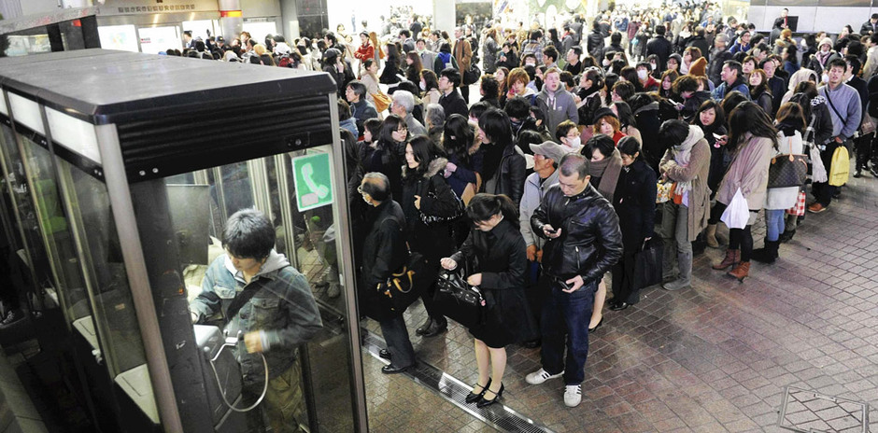
Communication is Fundamental
Queuing up to make a phone in Japan, 13 Mar 2011
Notes:
Lining up to make a call in Japan, 13 Mar 2011
http://news.enorth.com.cn/system/2011/03/12/006109266.shtml

Slide 32
People need information as much as water, food,
medicine or shelter.
Information can save lives, livelihoods and resources.
Information bestows power.”

Slide 33
Google People Finder
100x Agency App
What is your situation?
I'm looking for someone | I have information about someone
Currently tracking about 409300 records.
短縮 / Short URL : http://goo.gl/sagas (携帯対応 / Mobile OK) 災害に関する情報 / Other Resources NHK 安否情報も含みます/ with data from: NHK
Notes:
http://japan.person-finder.appspot.com/?lang=en as of 22 Mar 11
Compare: http://www.familylinks.icrc.org/wfl/wfl_jap.nsf/Bottin!OpenView&lang=ENG (with estimated 4,680 names – 180 A’s x 26 letters)

Slide 34
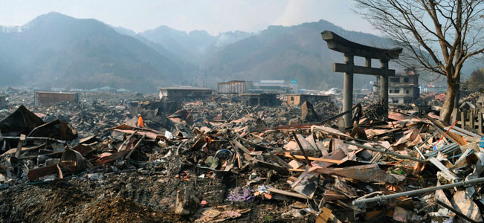
Japan Tsunami Aftermath – 14 Mar 11
A destroyed landscape in Otsuchi village,
Iwate Prefecture in northern Japan” -- Reuters/Kyodo
Notes:
http://news.yahoo.com/s/ap/ap_on_bi_ge/as_japan_earthquake_nuclear_crisis

Slide 35
What are the key questions?
What are you trying to do? (intent)
1:1 action? Amplify? Mass action?
Who is your audience?
Beneficiaries, Donors, NGOs, Volunteers?
What is fundamental in disaster relief?
Speed? Coverage? Accuracy?
Notes:
What’s fundamental in ER: deployed food, water, shelter
In development: sustainability

