Slide 1
Disruptive Innovation:
Train Wrecks on the Right Track
Edward G. Happ
IFRC, Global CIO
Sept 22, 2015

Slide 2

A Brief Introduction
3 careers: Wall Street, management consulting, NGOs
Current Global CIO at IFRC
Co-founder and former Chairman of NetHope.org
More on LinkedIn, Google and www.eghapp.com
Helping to Make
Connections For Good
2
Notes:
When I was 38, I read a comment by Handy saying we could expect to have 5 careers; for the millennials, they can expect to have 14 jobs…by the time they are 38! (see https://www.youtube.com/watch?v=XrJjfDUzD7M at 02:15)
http://www.amazon.com/The-Age-Unreason-Charles-Handy/dp/0875843018
Charles Handy, http://www.texasventures.us/india/images/leader2_1.jpg …five careers

Slide 3
Take-aways
Disruptions are surprises
We are anchored to the past
The world is shifting
Our roles depend on agility
Apply lessons from DR to IT

Slide 4

Are We Resilient?
Notes:
http://blog.thingamy.com/sigs_blog/management/

Slide 5
“Even if you are on the right track, you’ll get run over if you just sit there.”
--Will Rogers, American Humorist, 1879-1935

Slide 6
Strategic Context

Slide 7
IT Strategy Context
2. Get in
Competitive
or Leading
BENEFICIARY
“Differentiating”
Beneficiary & Field Facing
Increasing Impact for Beneficiaries
PROGRAM
“Improving Program Delivery”
3. Move up
Increasing Impact for Beneficiaries
OPERATIONAL
“Helping the Organization Run”
Efficient
Donor & HQ
Facing
FOUNDATIONAL
“Keeping the Lights On”
1. Get out

Slide 8
NGO/NS CIO Budgets
Beneficiary & Field Facing
33%
Competitive
or Leading
BENEFICIARY
“Differentiating”
Increasing Impact for Beneficiaries
PROGRAM
“Improving Program Delivery”
Donor & HQ
Facing
OPERATIONAL
“Helping the Organization Run”
67%
Efficient
FOUNDATIONAL
“Keeping the Lights On”
April 2012 survey of international non-profit organizations (n=23)
Notes:
37% foundational
32% operational
22% program
11% beneficiary

Slide 9
What does
the future
NGO Data Center
look like?

Slide 11
“We can't get close to what Google and Amazon [and Microsoft] can do in their data centers”
–Peter Cochrane
Why are we in the data center business?

Slide 12
Cloud providers are Tier 3 data centers
IFRC is here
Tier Level | Requirements
1 | Single non-redundant distribution path serving the IT equipment Non-redundant capacity components Basic site infrastructure with expected availability of 99.671% (28.8 hours outage in one year)
2 | Meets or exceeds all Tier 1 requirements Redundant site infrastructure capacity components with expected availability of 99.741%
3 | Meets or exceeds all Tier 2 requirements Multiple independent distribution paths serving the IT equipment All IT equipment must be dual-powered and fully compatible with the topology of a site's architecture Concurrently maintainable site infrastructure with expected availability of 99.982% (94.6 minutes outage in one year)
4 | Meets or exceeds all Tier 3 requirements All cooling equipment is independently dual-powered, including chillers and heating, ventilating and air-conditioning (HVAC) systems Fault-tolerant site infrastructure with electrical power storage and distribution facilities with expected availability of 99.995% (26.3 minutes outage in one year)
Cloud Providers are here
A 18x improve-ment
From Wikipedia article on data centers
Notes:
https://en.wikipedia.org/wiki/Data_center

Slide 13
Disaster Recovery Challenge Questions
For the Sept-2014 ETC Strategy Meeting, In five years:
Will the DR of Comm's in telcos and tech co's surpass our DR of Comm's capability?
Will cloud-sourced assessments surpass our assessment capability (in quality, speed and reach?)
Will community to community, and corporations to community program delivery surpass our program delivery means?
Will we see BYO-DR among responders surpass the DR we supply?
What will we do better than others in 2020 and how will that be different than what we have done better? Will our leading expertise shift?
The operative word here is “surpass”
13
Notes:
Note the word "surpass" in the above points. And the underlying issues of change and trust.

Slide 14
Agility is a Necessity…
In times of stress, organisms vary like mad, with pilots, prototypes, and trials.
14
Notes:
Echoing Jim Collins, “when there is rapid change and uncertainty, smart organizations vary like mad.” This takes a certain kind of humility: admitting that when it comes to the future of technology we most often don’t know. This may be a bit philosophical, as my editor pointed out—after all, people want to know about the impact of the “cloud.” My short answer is that it will be different than we expect; so make your bets small, shared and vary like mad.

Slide 15
How agile are we to technology and business change?
Our Agility Index is 0.22
number of project phases lasting less than 3 months
15
Notes:
*number of project phases lasting less than 3 months / number of project phases lasting more than 3 months

Slide 16
We Don’t Do Large Well
“… a staggering 31.1% of [IT] projects will be cancelled before they ever get completed. Further results indicate 52.7% of projects will cost 189% of their original estimates.” --Standish Chaos Report, 2014.
And this has not improved in the 30+ years of their tracking software projects
Notes:
http://www.standishgroup.com/about; http://www.projectsmart.co.uk/docs/chaos-report.pdf

Slide 17
Disruptive Change

Slide 18
Three Types of Innovation*
Empowering (or disruptive) innovation – “transmutes complicated and costly products available to a few into simpler, cheaper products accessible to many” “creating new markets and wreaking havoc within industries” (e.g., Ford Model T car)
Sustaining innovation – “replaces old models with new products that often incorporate new technology and novel design features.” “making things incrementally bigger, more powerful, and more efficient” (ex. Toyota Prius)
Efficiency innovation – “makes existing products more proficiently” (ex. Lean production)
Only disruptive innovations create new jobs
*Clay Christensen, Davos interview, January 2013
The false comfort of incrementalism
Notes:
See http://www.davidkhurst.com/clayton-christensen-at-davos-an-ecological-perspective/
and http://www.wired.com/business/2013/02/mf-clayton-christensen-wants-to-transform-capitalism/all/

Slide 19
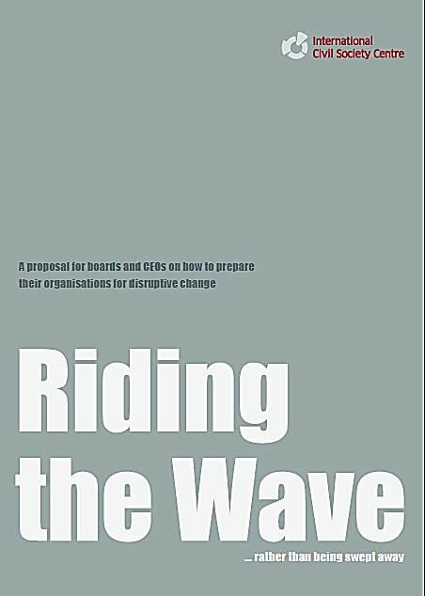
Disruptive Change
International Civil Society Centre, Berlin, October 2013
The topic of disruptive change has gone main-stream; no ICSO leader doubted its relevance, threat and opportunity.
http://icscentre.org/area/riding-the-wave
19
Notes:
http://icscentre.org/area/riding-the-wave

Slide 20
Scale + speed + surprise
= disruption
“…over the last 20 years change itself has changed: it has become faster, more fundamental and more surprising. When these three elements come together, we experience disruption.”
--Riding the Wave, October 2013

Slide 21
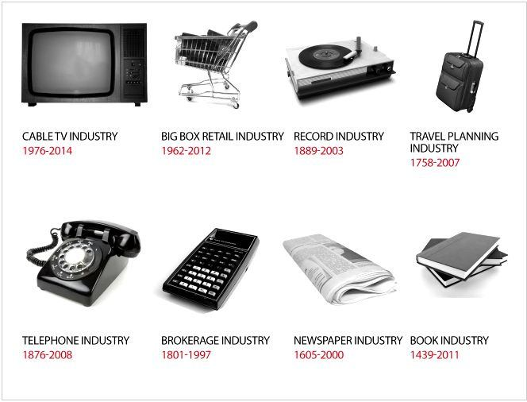
Industries RIP
21
Notes:
Motley Fool Newsletter, August 3, 2013, at 15:36 here: http://www.fool.com/fool/free-report/18/sa-cabletvaudio-253366.aspx?source=isaspodft0000782

Slide 22
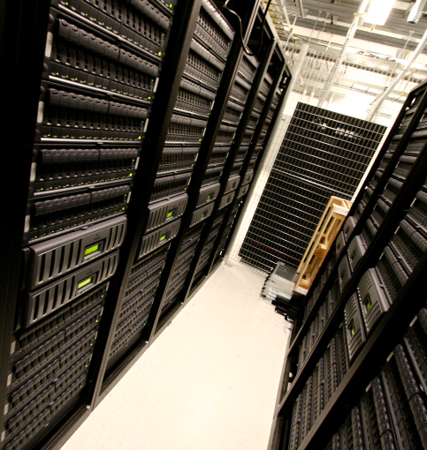
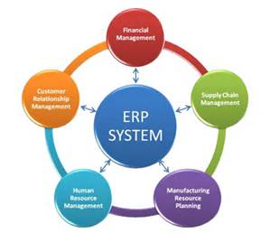
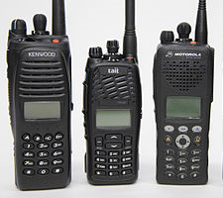



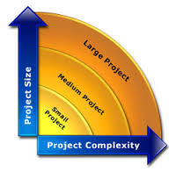
Potential NGO Technology Wrecks?
Data centers | ERPs | Radio | Laptops
Email | Cables | Large projects | ?
22

Slide 23
Overheard at the ETC Strategy Meeting
“At some point someone needs to pull a cable.”
What if there are no cables?

Slide 24
The Nature of the Network is Changing
The “ways in which communities use technology is based on fundamentally different ways of organising and managing a response. Community based models tend not to be top down or command-and-control, but to be a networked response,
a digital expression of the neighbour-to-neighbour model of providing help.”
–Imogen Wall
Uberfication, Airbnb Shelter, Humanitarian TripAdvisor?

Slide 25
Some Lessons

Slide 26
What we can learn from disaster relief about management of IT organizations?
  Urgent: There is a burning platform and we are jumping (Opposite of change initiative)
  Fast: people need attention immediately
  Lean: red tape is something to be cut
  Attentive: listen and amplify the voice of those on the ground
  Flat: Management requests are overhead; diminishing returns on process
  Good enough is good enough
  Costs are last: Don't worry about the costs, worry about the speed
  Preparing is not executing: Planning is preparedness, not execution
  Improvising: Apollo 13: make do, get in done, opportunity to shine, all hands on deck
  Humanitarian: care, trust, and humility
26
Notes:
From my May 2014 ISCRAM keynote: "Managing the Disasters within: what we can learn from disaster relief”

Slide 27
What we can learn from disaster relief about management of IT organizations?
  Urgent: There is a burning platform and we are jumping (Opposite of a change initiative)
  Fast: people need attention immediately
  Lean: red tape is something to be cut
  Attentive: listen and amplify the voice of those on the ground
  Flat: Management requests are overhead; diminishing returns on process
  Good enough is good enough
  Costs are last: Don't worry about the costs, worry about the speed
  Preparing is not executing: Planning is preparedness, not execution
  Improvising: Apollo 13: make do, get in done, opportunity to shine, all hands on deck
  Humanitarian: care, trust, and humility
27

Slide 28
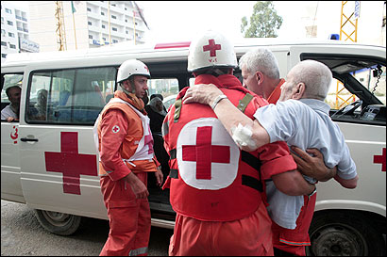
Fast…
28
Notes:
http://www.boston.com/news/world/articles/2006/07/25/ambulance_drivers_tell_tales_of_horror/

Slide 29
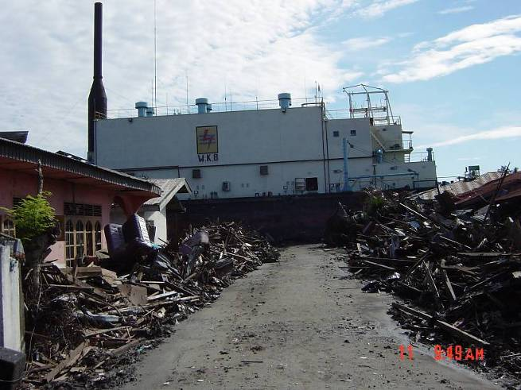
Good Enough…
Following the Tsunami response, a marketing director recalled, “We didn’t have time to have all the meetings, all the reviews, and all the approvals.” “We had to make on-the-spot-decisions.” “The interesting thing”, she continued,” is that nothing fell apart.” “Maybe we could make decisions like that everyday.”
Banda Aceh, 2004
“The Good Enough Principle “ June 2008

Slide 30
Humanitarian…
We care
  People are vulnerable
  People are hurting
The customer is the first responder
  90% of first responders are local people
  Resilience is not a gift…
  it’s preparation and adaptability
Notes:
It’s ownership

Slide 31
Will we be able to move fast enough?
Read the “Relevant IT Manifesto”
http://eghapp.blogspot.ch/2011/07/relevant-it-manifesto.html
Notes:
http://blog.thingamy.com/sigs_blog/management/

Slide 32

Questions?

Slide 34
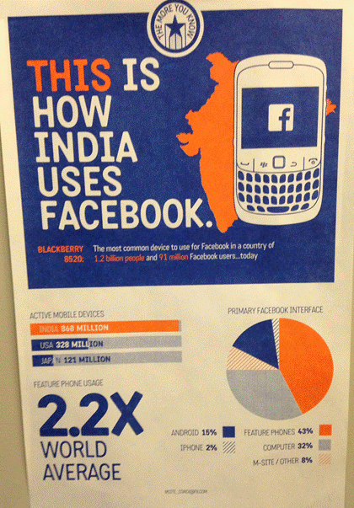
Poster seen
At Facebook
Feature phones account for 43% of Facebook usage in India.
Only 17% access via smartphone
Feature phone usage is 2.2x the world’s mobile phone average

Slide 35

The Movie Clip
“And you, sir, are a steely-eyed missile man”
Three clip, starting here: https://www.youtube.com/watch?v=C2YZnTL596Q
Notes:
The Apollo 13 mission CO2 filter problem solving is in 3 video clips:
https://www.youtube.com/watch?v=C2YZnTL596Q
https://www.youtube.com/watch?v=Zm5nUEG5Bjo
https://www.youtube.com/watch?v=ze1hmt4_wPg
Question, what problem do we have that has very limited resources to solve with a very tight deadline; how can we find a creative, ripped-duct-tape solution?
Photo: http://www.imdb.com/media/rm1413254656/tt0112384

Slide 36
Synopsis
As humanitarians, disruptions seem to lurk around every corner. Yet the digital world has brought us expected disruptions. How do we stay resilient and turn these disruptions into success? Join us for a virtual presentation by Ed Happ, IFRC’s Global Chief Information Officer, at 10 a.m. on Tuesday, September 22nd.
Based on his experiences working on Wall Street, as a management consultant and with NGOs, Ed will share insights on how organizations can adopt and leverage disruptive changes.
The late American humorist, Will Rogers, once quipped that “Even if you are on the right track, you’ll get run over if you just sit there.” And yet large parts of our Civil Society Organizations (CSOs) infrastructure is based on last century models. A recent study by the International Civil Society concluded that “The role CSOs will play in tomorrow’s world may very much depend on their ability to anticipate and effectively navigate disruptions.”
Disruptive change is about scale, speed and surprise; the point being that it is hard to plan for, but imperative to be flexible and agile for. Will we be able to move fast enough to avoid the train-wreck?
We hope you will join us for this thought-provoking discussion and consider how to positively leverage the disruptions in your work.

